Slide 1
Project Title : ToDoList
Name and Roll No: Ashmita
2210990190

Slide 2
Index
Objective
Introduction
Methodology, Approach & Techniques
Algorithm
Result
Source Code (screenshots)
Conclusion
Reference

Slide 3
Objective
The objective of the ToDoList function is to maintain list of tasks.
This code helps to print your ToDoList.

Slide 4
Introduction
It is a To-Do-List project using Python programming language.
Prints the tasks to be performed at the end of code.
Tools: Python
Built-in modules: input()
print()

Slide 5
Methodology, Approach & Techniques
The methodology involves leveraging the code to ensure accuracy and efficiency.
Start with implementing basic functionalities (such as adding, removing, and viewing tasks) and gradually add more features based on priorities and user feedback.

Slide 6
Algorithm
Input
Adding a Task
Removing a Task
Viewing Tasks
Main Functionality Loop
Menu Options
Input Handling
Error handling
Script Execution

Slide 7
Result
The result of running the To-Do-List code will provide us with the
List of tasks to be performed.

Slide 8
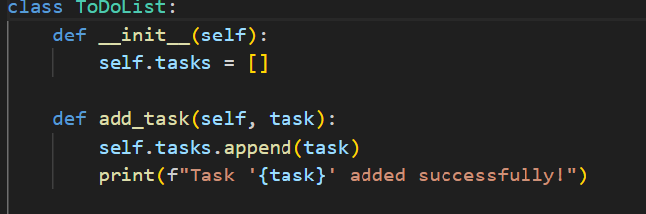
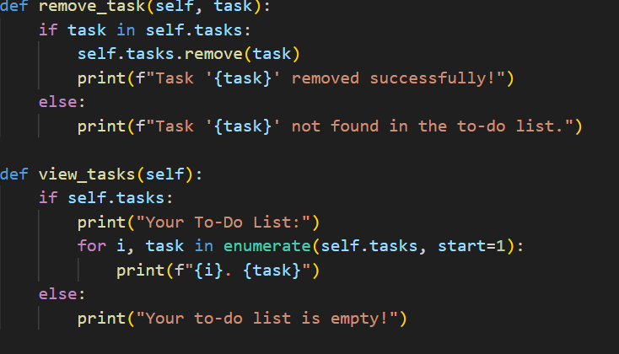
Source Code (screenshots)

Slide 9
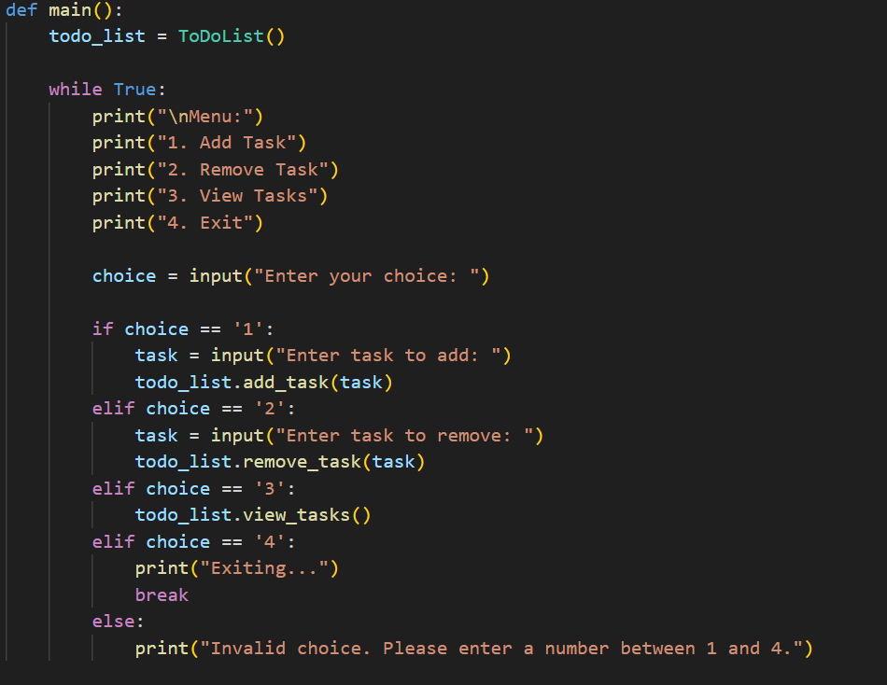


Slide 10
Conclusion
In conclusion, the todo list Python project presented a simple yet effective solution for managing tasks efficiently. By leveraging Python's built-in functionalities and object-oriented programming principles, we successfully implemented a command-line todo list application with the ability to add, remove, and view tasks.

Slide 11
Reference
GeeksForGeeks
Javapoint

Slide 12
The End

